Slide 1
Wellness Company Fitness Devices Plan
Presented by : Mina Attia

Slide 2
Contents
01
Our Challenge
02
Market situation
03
Moving Forward
04
Conclusion

Slide 3
Our Challenge
01

Slide 4
Our Challenge
How to approach the fitness devices for women
what can we do to be unique in the market
How to satisfy the customer needs
How to guarantee a market share and significant ROI

Slide 5
Market Situation
02

Slide 6
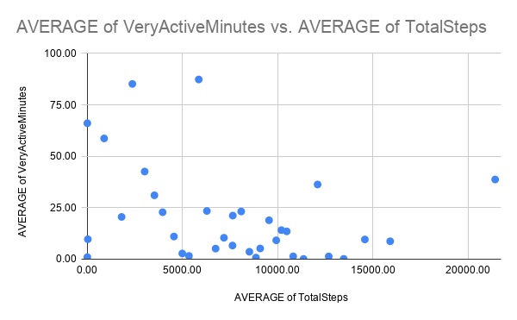
Market Situation
Extremely Active (Athletic)
Sedentry / Casual Activity

Slide 7
Moving Forward
03

Slide 8
Moving Forward
The Market is Extremly split between Highly Active and Casual /sedentry women
The best approach is two provide two devices at once
One low cost device to cater for the casual users the don’t need to log or monitor every aspect
Another medium to high cost device for the athletic women that tracks every possible finding

Slide 9
Conclusion
04

Slide 10
Conclusio
The clear split in the market pushes for dual devices
This strategy insures market share with all customers
The low cost device could include motivations or point system/ badges to push for more activity
The high cost one could focus more on accuracy and challenging the user to push themselves

Slide 11
THANKS
Mina Attia

